Slide 1
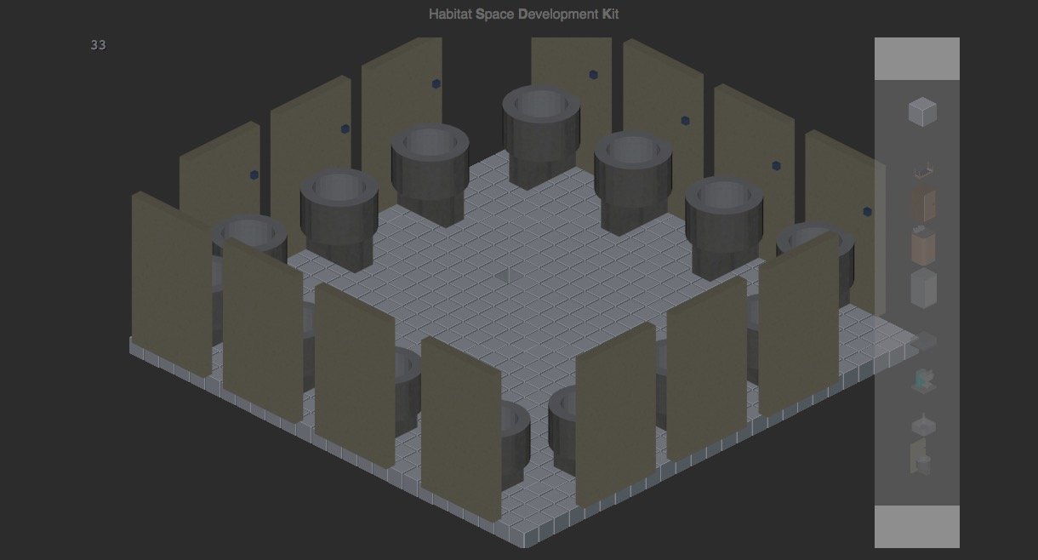
HabSDK
The Habitat Space Design Kompetition

Slide 2
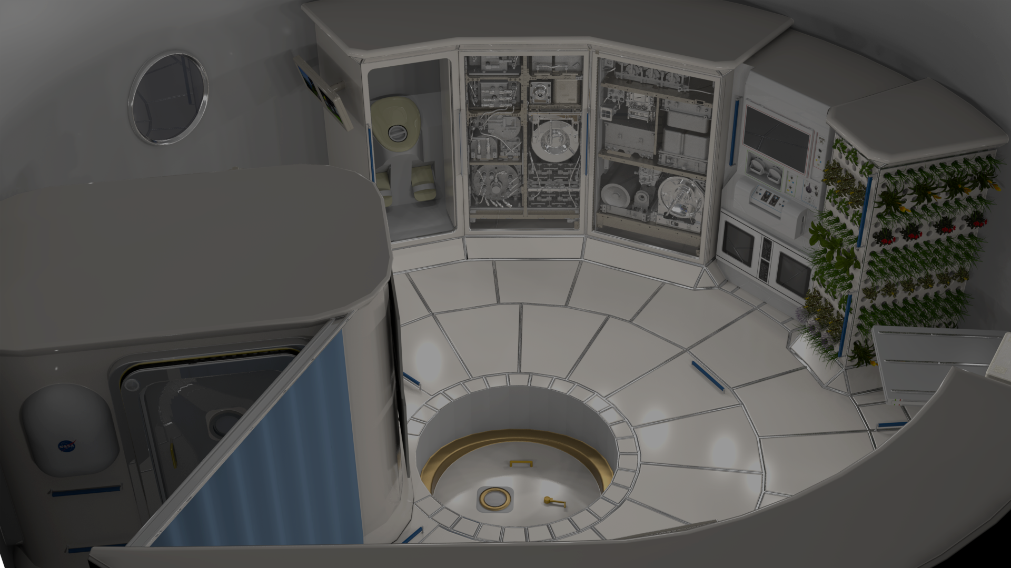
The Challenge:
Design a layout for the habitation area that would accommodate all the activities that take place inside it.

Slide 3
The solution
Designing is hard. Other people should do it.
Create a crowdsourcing game
Allow users to design the habitat using a large library of components
Like beds, food preparation, toilets, treadmill (bluemix servers, four poster bed, incinerator, kettle, sofa)
Rate the design using metrics,
like overall weight, power consumption, (sanity, number of toilets, hipster-ness, moisture, flammability)
Create a website for designs
designs can be submitted, viewed and ranked.

Slide 4
habsdk.co

Slide 5
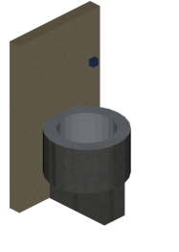
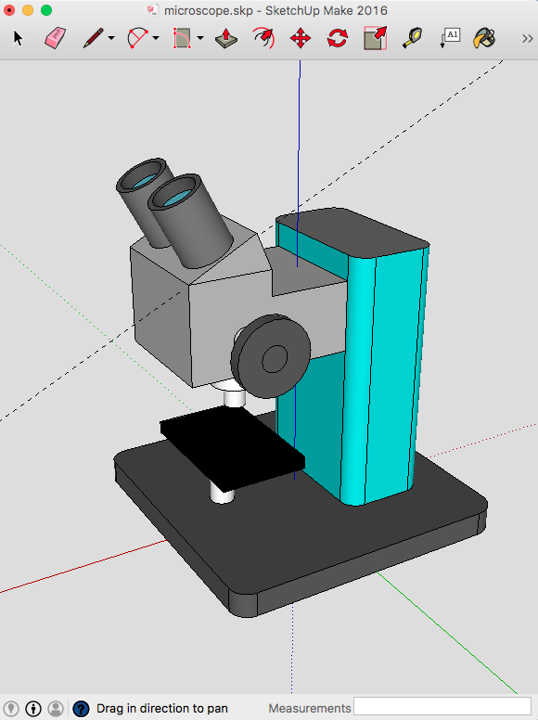
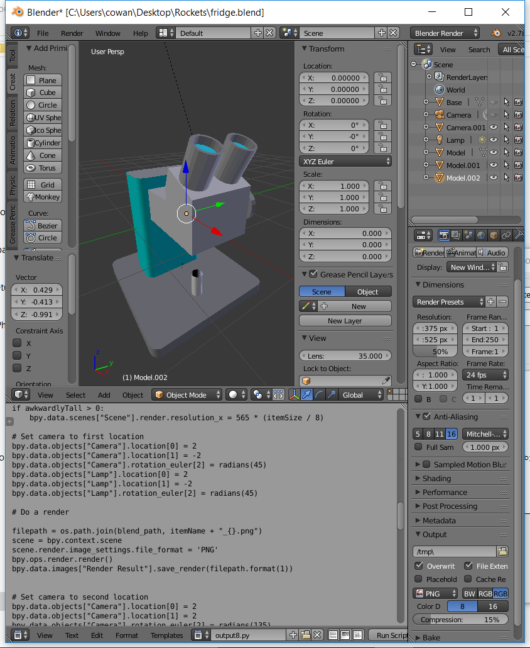
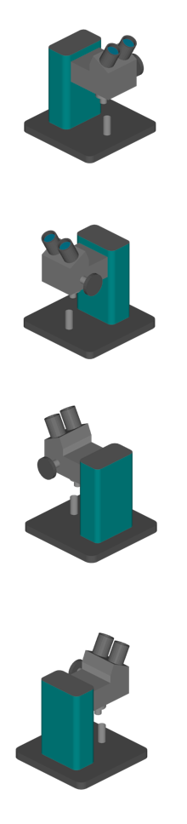
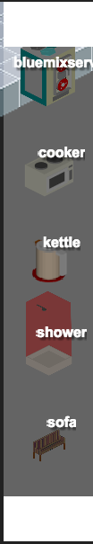
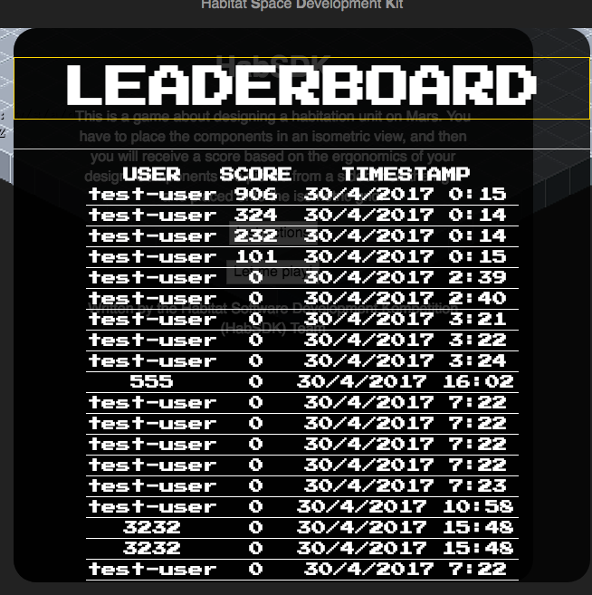
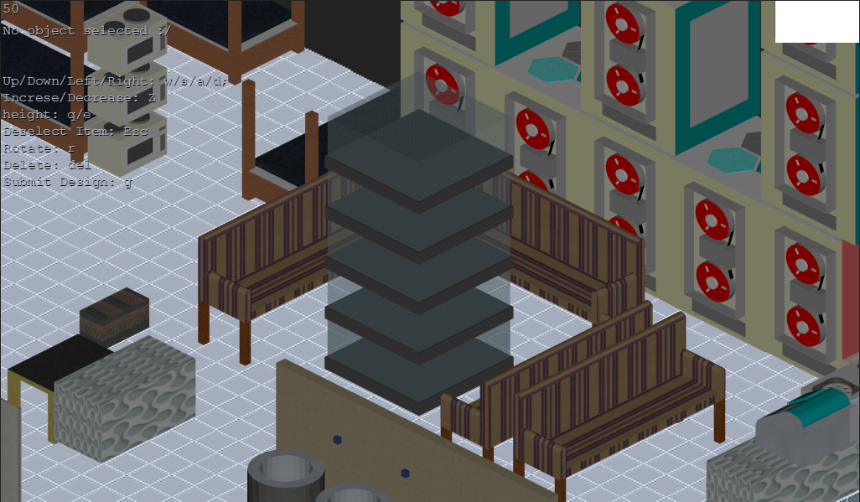
Design in Sketchup
Convert to isometric images in blender
Import as resources into the game
Client side habitat designer in Phaser.js
Submit to a node js webserver for ranking!

Slide 6
Problems
A lot to get done in the time
We all hate Javascript and always seem to forget
Too many toilets

Slide 10
Uses
Design and optimize the layouts (as the challenge suggests!)
Crowdsourcing a solution
Educational tool

Slide 11
Further Steps
Improve the resources library
Improve the metrics
Reduce the percentage of bugs to less that 100% (reach pre-alpha)

Slide 12
HabSDK
The Habitat Space Design Kompetition
Source: www.github.com/habsdk
Space Apps Team: https://tinyurl.com/habsdk

